Slide 1
The role of abstraction in compositionality in human and artificial neural networks
Taku
Tim Klinger (IBM)
Doug
Mike
Mattia Rigotti (IBM)

Slide 2
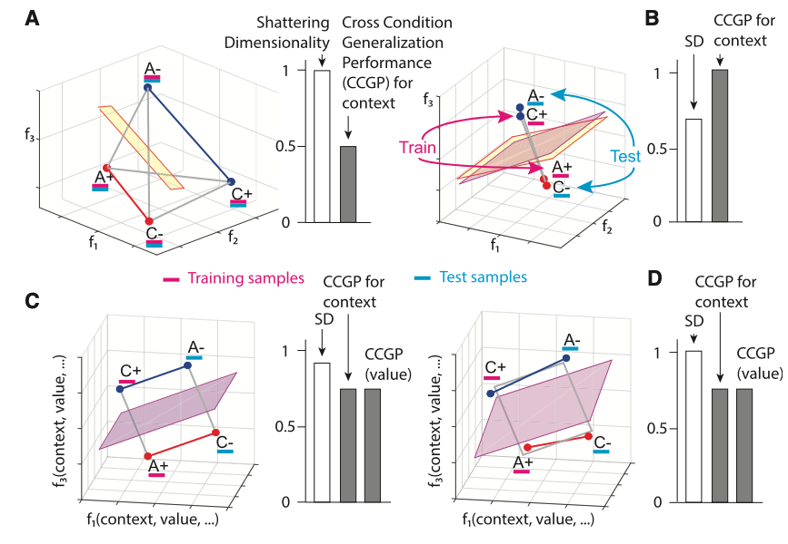
What internal representations are useful for compositional generalization?
Shattering dimensionality versus generalizability/abstraction
Colors: Stimuli conditions
-/+: Reward conditions
High shattering dimensionality –> not ideal for generalizability to new contexts

Slide 3
How are compositional representations in the human brain formatted?
High shattering dimensionality vs. abstract format?
Previous work has shown:
Compositional codes in human prefrontal cortex (Reverberi et al. 2012)
Abstract codes in non-human primate prefrontal cortex and hippocampus (Bernardi et al. 2020)
Little work has focused on:
Geometric format of compositional codes in humans and their importance
Our objective:
We characterize the geometric format of compositional codes in humans
Demonstrate their utility for compositional generalization in ANNs

Slide 4
Main questions
Do humans represent task information abstractly?
What are the benefits of compositional and abstract representations?
Hypothesis: Compositional behaviors benefit from abstract and generalizable representations in both humans and ANNs
Specific approach:
Characterize the geometric format (degree of abstractedness) in human fMRI data during a compositional task
Identify whether or not these ‘abstract formats’ emerge when an ANN is forced to learn compositionally
Characterize (and illustrate) the computational benefits of these abstract representations in models

Slide 5
General outline of results
Empirical human results
Evidence of compositionality in human behavior
Evidence of abstraction and compositional representations in whole-brain human imaging
2. ANN modeling results
Evidence of abstract representations when ANNs are forced to learn compositionally (i.e., learning primitives via pretraining)
Evidence of systematic, zero-shot generalizability with compositional abstraction
3. Current/future work (?)
Optimizing models for compositional, abstracted, and clustered internal representations to facilitate efficient learning and generalizability in compositional tasks

Slide 6
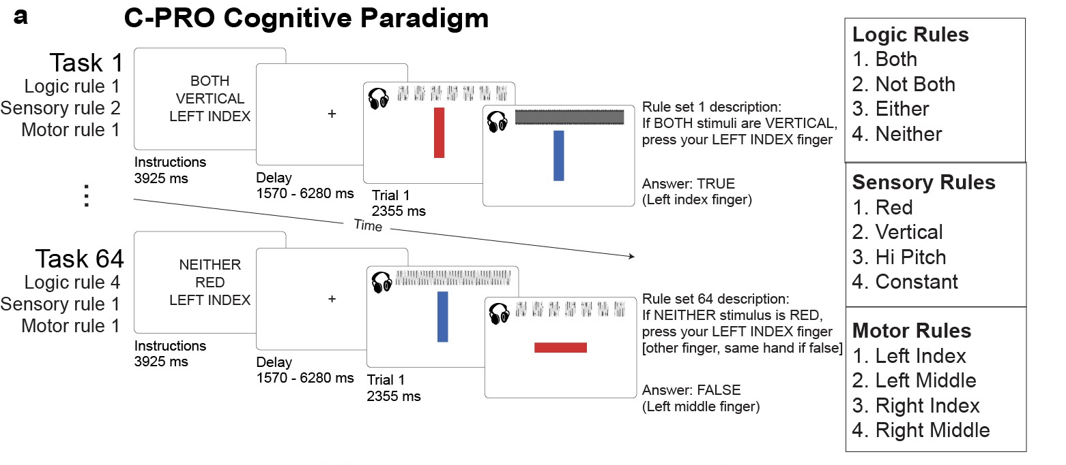
Task – Concrete Permuted Rule Operations (C-PRO)

Slide 7
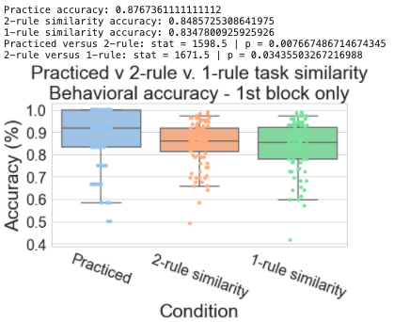
Evidence for compositionality in human behavior
The average performance of all 64 unique tasks (1st trial only)
Practiced tasks had highest performance
Tasks with more overlapping rules with practiced task had marginally higher task performances
Performance reflects likely compositional reasoning in human behavior

Slide 8
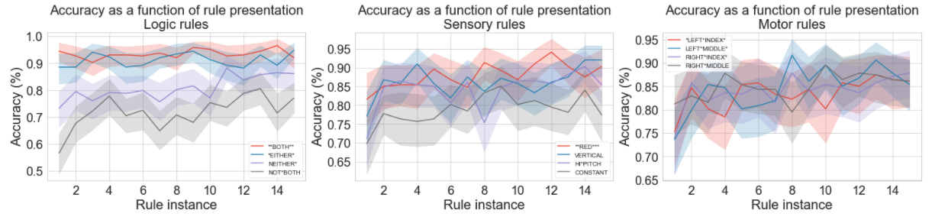
Evidence for compositionality in human behavior
For each rule, we track the performance of new tasks that include previously viewed task rules
Performance increases as a function of task rule viewings (despite being used in a new context), suggesting compositional learning and re-use of task rules

Slide 9
General outline of results
Empirical human results
Evidence of compositionality in human behavior
Evidence of abstraction and compositional representations in whole-brain human imaging
2. ANN modeling results
Evidence of abstract representations when ANNs are forced to learn compositionally (pretraining on primitive tasks)
Evidence of systematic, zero-shot generalizability with compositional abstraction
3. Current/future work (?)
Optimizing models for compositional, abstracted, and clustered internal representations to facilitate efficient learning and generalizability in compositional tasks

Slide 10
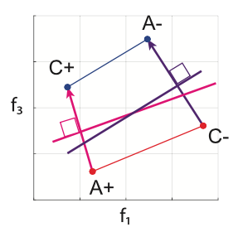
How do we measure abstraction and compositionality in neural data?
Calculating the parallelism score (PS)
Blue/red dots : stimulus conditions
+/- : reward conditions
If we’re interested in seeing how generalizable a decoder for context (i.e., the blue dots) are, we evaluate the similarity of angles between decoders
So, we can compare the cosine (dot product) between the purple and pink vectors
Bernardi et al. (2020) Cell

Slide 11
Measure abstractedness using parallelism score
BOTH
RED
LMID
BOTH
VERTICAL
RMID
a₂
b₂
A
B
a₁
b₁
EITHER
RED
LMID
EITHER
VERTICAL
RMID
Objective: Compute the angle between A and B, where
A = a₂ – a₁
PS = mean {||A|| • ||B||}
for every possible BOTH v. EITHER combination
B = b₂ – b₁

Slide 12
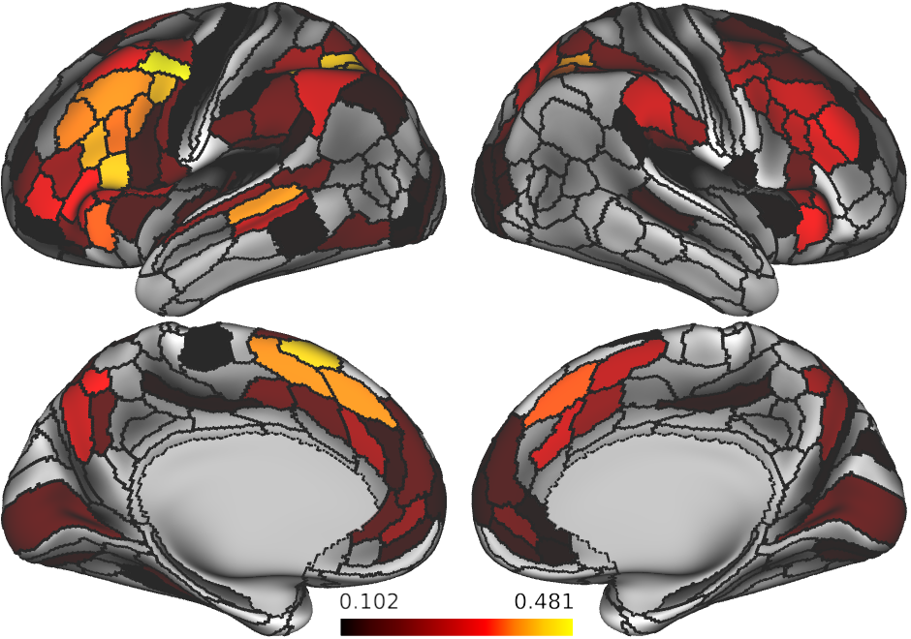
Logic rule parallelism – statistical significance assessed using alpha=0.05 on shuffled data
Abstract representations for logic rules are lie mostly in frontoparietal ”task positive regions”

Slide 13
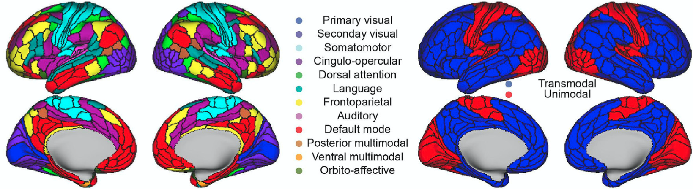
Reference of what functional networks organization in the human brain

Slide 14
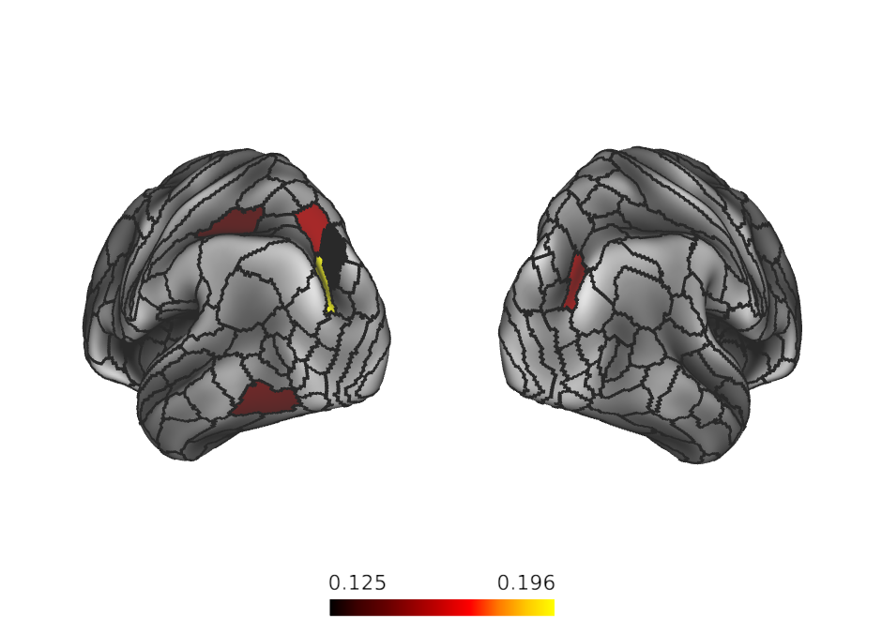
Sensory rule parallelism – statistical significance assessed using alpha<0.05 on shuffled data
Abstract representations for sensory rules are lie mostly in higher order visual areas and some dorsal attention network regions

Slide 15
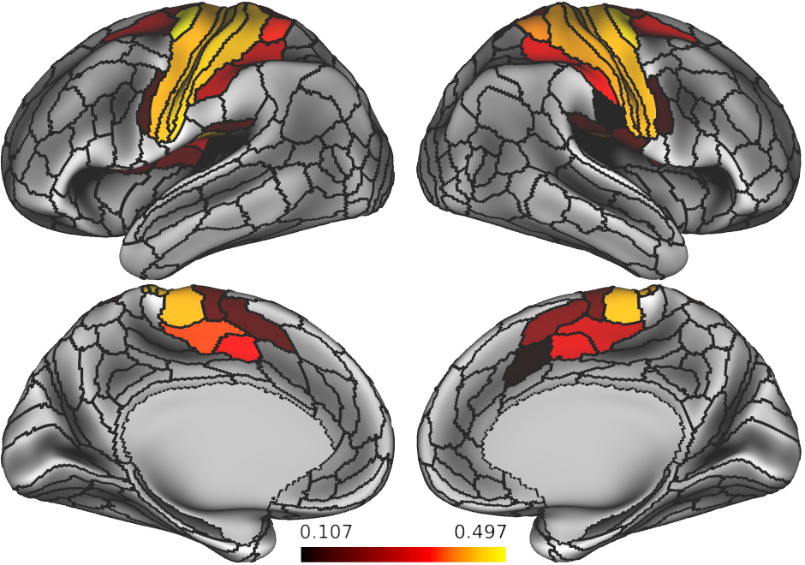
Motor rule parallelism – statistical significance assessed using alpha<0.05 on shuffled data
Abstract representations for motor rules are mostly lie in higher order visual areas and some dorsal attention network regions

Slide 16
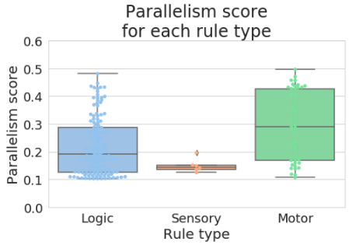
How about the overall degree of parallelism per rule domain?
Sensory rules appears to have an intrinsically lower parallelism score relative to other rule domains
Is this due to the data, or a function of the task?

Slide 17
General outline of results
Empirical human results
Evidence of compositionality in human behavior
Evidence of abstraction and compositional representations in whole-brain human imaging
2. ANN modeling results
Evidence of abstract representations when ANNs are forced to learn compositionally (pretraining on primitive tasks)
Evidence of systematic, zero-shot generalizability with compositional abstraction
3. Current/future work (?)
Optimizing models for compositional, abstracted, and clustered internal representations to facilitate efficient learning and generalizability in compositional tasks

Slide 18
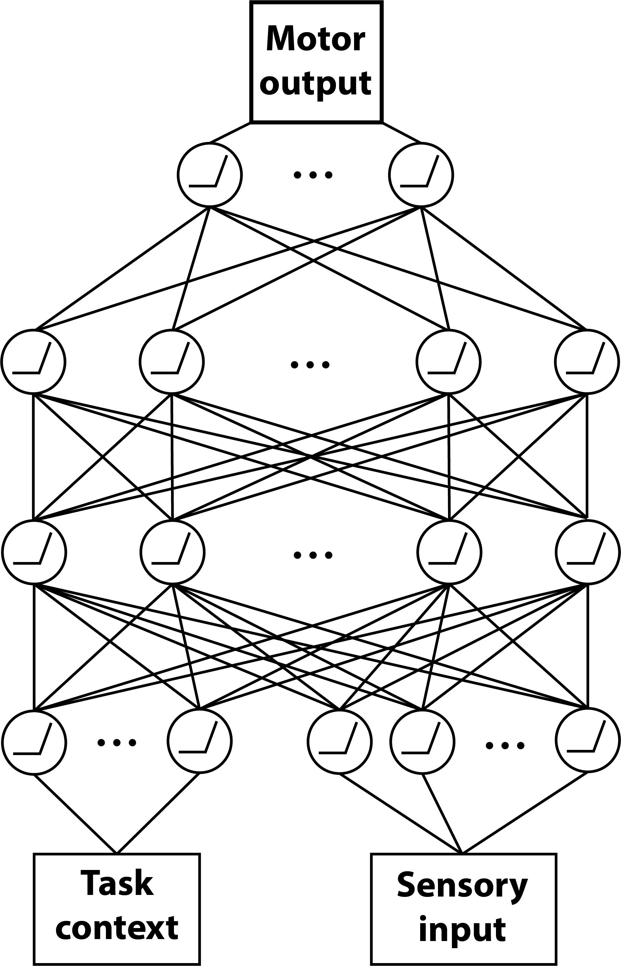
Model architecture – simple feedforward network
4 units
256 units
256 units
11 (context) + 16 (sensory) units

Slide 19
Analysis 1 – Force an ANN to learn compositionally through training on primitive tasks
Build a model to perform the C-PRO task
Evaluate compositional behavior on a network trained on 4 tasks with pretraining (on compositional primitives) and without
Does the ANN exhibit similar compositional behaviors to humans?

Slide 20
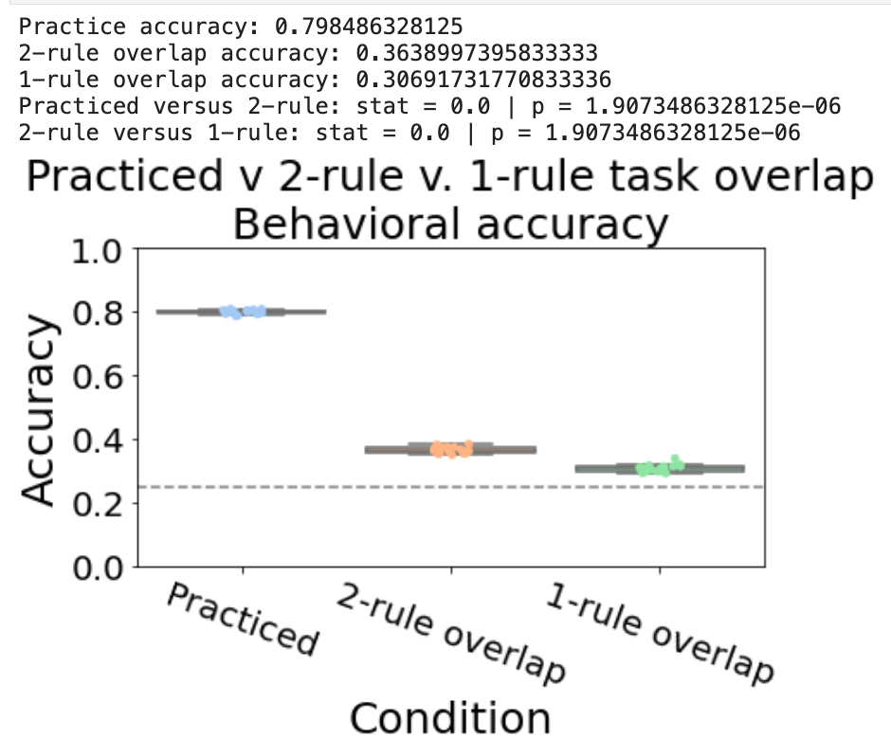
Train a model to perform 80% accuracy on 4 practiced tasks – evaluate on novel tasks
Model naturally exhibits similar compositional behavior similar to humans

Slide 21
Designing primitive tasks for ANNs to learn concepts
A simplified set of C-PRO tasks:
2-rule ’primitive’ tasks
1-rule ’primitive’ tasks

Slide 22
Analysis 1 – Simplified 2-rule pretraining approach
Two simplified tasks:
Sensorimotor task:
If RED press LEFT MIDDLE
If VERTICAL press RIGHT INDEX
Logical-sensory tasks
If BOTH RED -> TRUE/FALSE
If NEITHER VERTICAL -> TRUE/FALSE

Slide 23
2-rule sensorimotor task
RULE
Stimulus
ACTION
RED
LEFT INDEX
“LEFT INDEX”
If RED, press LEFT INDEX
RULE
ACTION
NOT RED
LEFT INDEX
“LEFT MIDDLE”
If NOT RED, press LEFT INDEX

Slide 24
2-rule Logical-sensory task
“True”
BOTH
VERTICAL
“False”
“True”
EITHER
RED
“False”

Slide 25
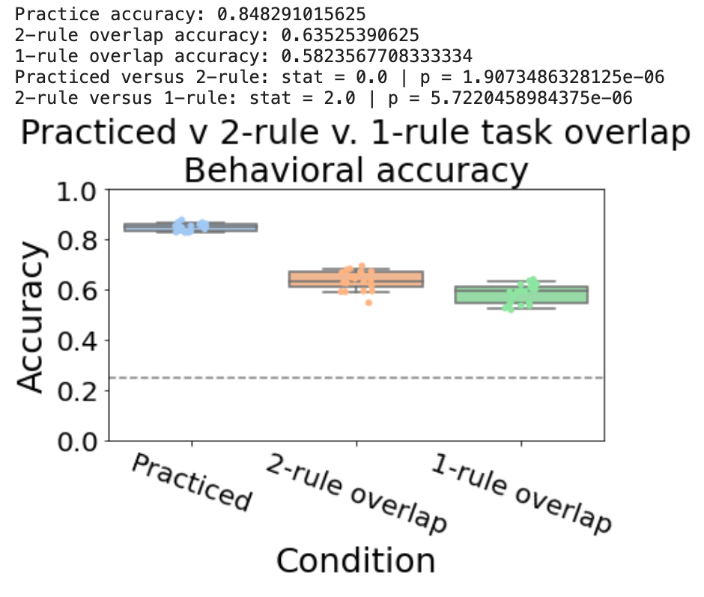
Accuracy significantly improves with pretraining on 2-rule primitive tasks while maintaining compositional behavior

Slide 26
1-rule simple task – Motor learning
RULE
ACTION
RIGHT INDEX
“Right index”
Press right index button
RULE
NOT RIGHT INDEX
ACTION
“Right middle”
Press *NOT* right index (Right middle) button

Slide 27
1-rule simple task – Sensory learning
RULE
Stimulus
ACTION
RED
“TRUE”
Is the stimulus red?
RULE
ACTION
NOT RED
“FALSE”
Is this stimulus *NOT* red?

Slide 28
1-rule simple task – Logic learning
“False”
“True”
BOTH
“False”
“True”

Slide 29
1-rule simple task – Logic learning
RED
RED
“True”
RED
RED
“True”
EITHER
BLUE
RED
“True”
BLUE
BLUE
“True”

Slide 30
How do each of these networks (no pretraining, 2-rule pretraining, and 1-rule pretraining) perform on held-out novel CPRO tasks?

Slide 31
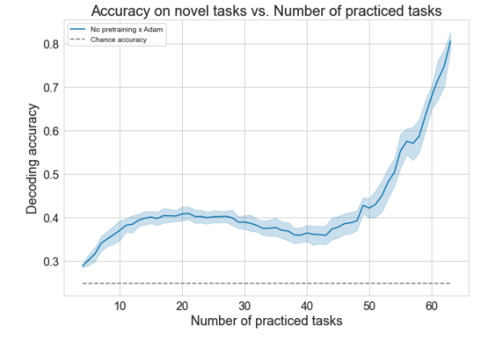
Networks without pretraining are slow to generalize on new tasks
Accuracy on novel tasks

Slide 32
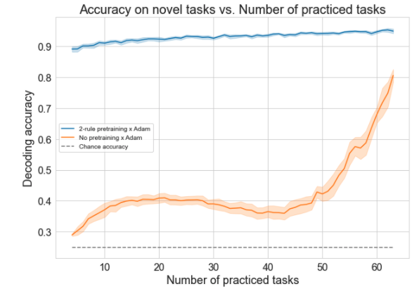
Networks with 2-rule pretraining generalize almost immediately
Accuracy on novel tasks

Slide 33
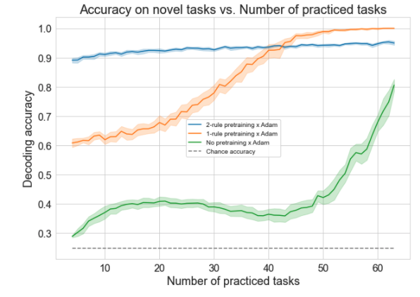
Networks with 1-rule pretraining doesn’t generalize immediately, but surpasses generalization on 2-rule pretrained networks
Accuracy on novel tasks
Pretraining on simple ‘primitive’ tasks (i.e., concept learning) significantly improves generalization ability

Slide 34
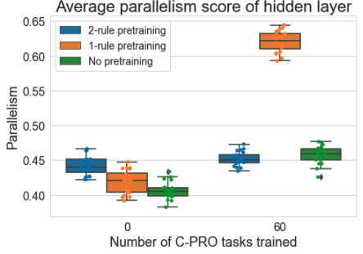
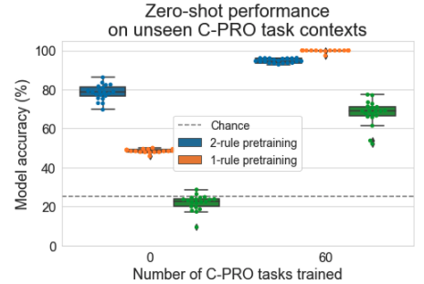
Do the internal ANN representations differ with pretraining?
Abstractly formatted representations (high parallelism) appears to facilitate generalization to novel tasks

Slide 35
Parallelism by rule type
PS from empirical brain data
Gray distribution is the “null”
Domain specific abstraction in ANNs (with compositional training)
mimics abstraction in the brain

Slide 36
Summary of results
Humans exhibit compositionality in task performance between familiar and novel task types
Humans exhibit compositional brain representations as exhibited by parallelism scores across rule types
ANNs can exhibit compositionality, if pretrained with useful compositional primitives
This affords generalizability as evidenced by zero-shot learning
Abstract and efficient representations may underlie the ability to generalize in both humans and ANNs

Slide 37
An aside
I ran a preliminary analysis where I altered the cost function of the ANN to optimize for abstraction
The hypothesis: optimizing for abstraction would be as good as ‘pretraining’ on primitives
By optimizing for abstraction we wouldn’t require pretraining
However, this analysis/model failed.
Suggests that abstraction alone is an insufficient condition for quick generalization

Slide 38
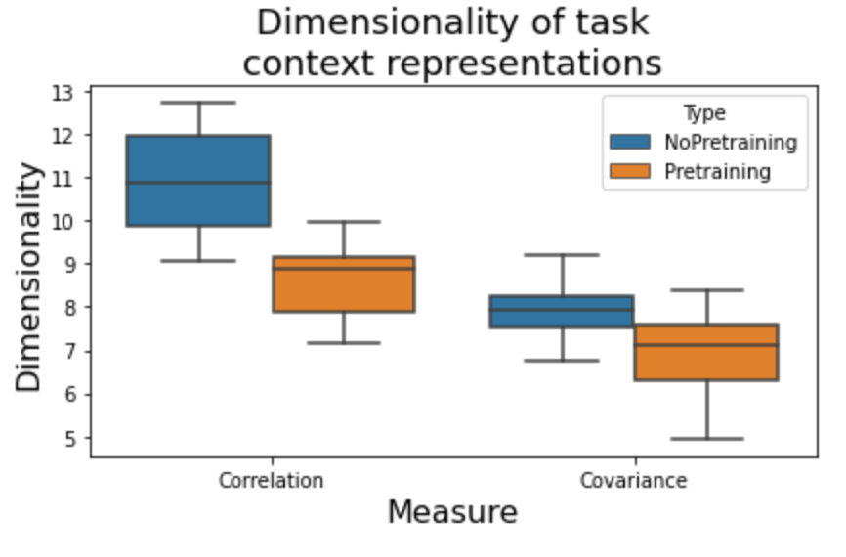
Pretraining of networks also results in reduced dimensionality, another form of abstraction
Dimensionality in the feature space

Slide 39
What is the benefit of compressed, lower dimensional representations of the task context?
Do compressed context representations influence behavioral representations?

Slide 40
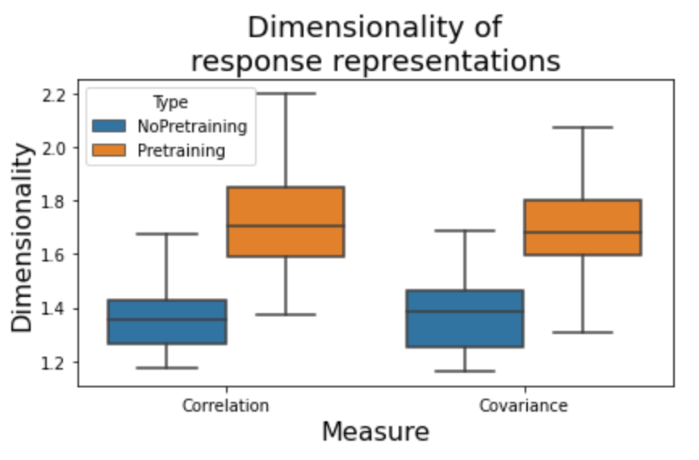
Do pretrained, compositional ANNs have higher dimensional behavioral representations (also have higher decoding accuracies)
Suggests abstract, compositional representations are useful for extracting relevant behavioral representations

Slide 41
Hypothesis / Prediction from model?
Makes 2 predictions: Increased compositionality leads to…
Improved behavioral representations for decoding
Lower dimensional context representations
Can be tested in empirical data by evaluating decodability of context and response (separately) as a function of rule presentation
*perhaps can serve as a hypothesis/explanation as to why PFC areas have such low decoding accuracies of context info

Slide 42
ANN experiment 2
Iteratively train networks on n practiced tasks, and test on 64 – n novel tasks
Tests for ‘one shot learning’
If networks are learning compositionally, they should likely improve performance as n increases
4 network types (all trained on 150 epochs)
ANN with pretraining (SGD)
ANN with pretraining (Adam)
ANN (SGD) – no pretraining
ANN (Adam) – no pretraining

Slide 43
Earlier hypothesis:
Lower dimensional task context representations
➔
Higher dimensional response representations
So, across training, does reduced context dimensionality correlate with response dimensionality?

Slide 44
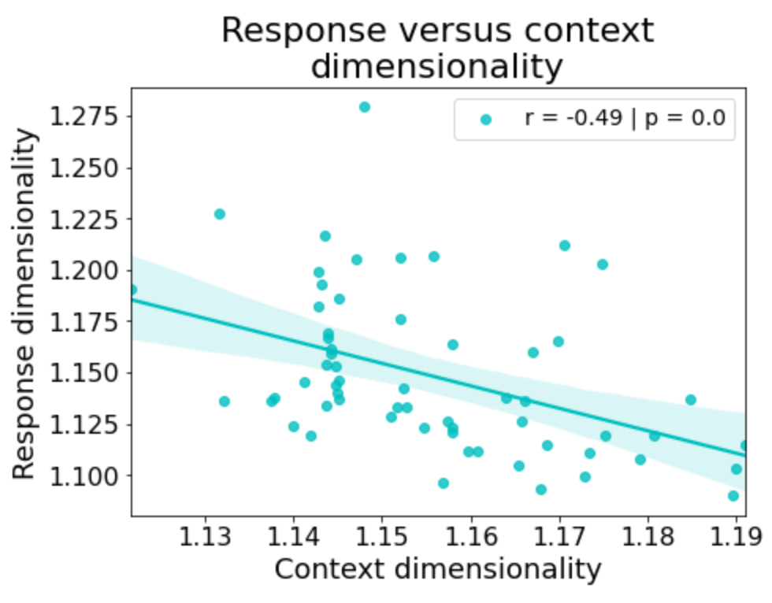
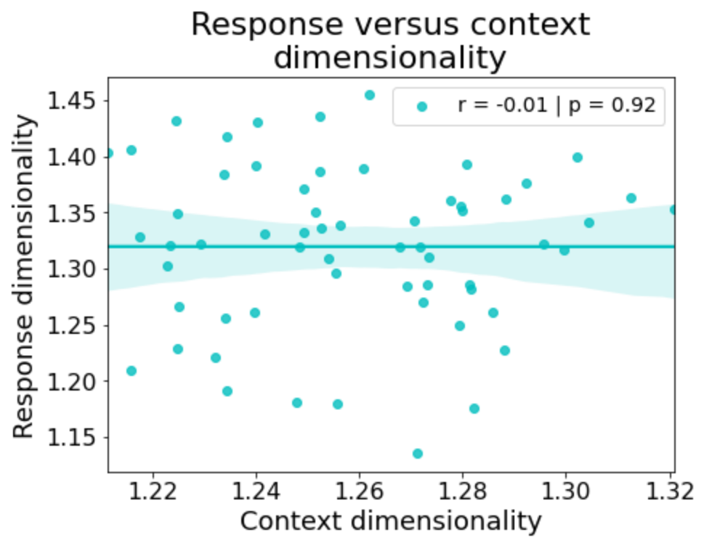
Adam + Pretraining
SGD + Pretraining
Unclear why there is this distinction… though Adam does train much more quickly/efficiently than SGD

Slide 45
Leads to a testable hypothesis in data:
Lower dimensional task context representations
➔
Higher dimensional response representations
In prefrontal areas
Can also evaluate how dimensionality is shaped across each presentation of a new rule

Slide 46
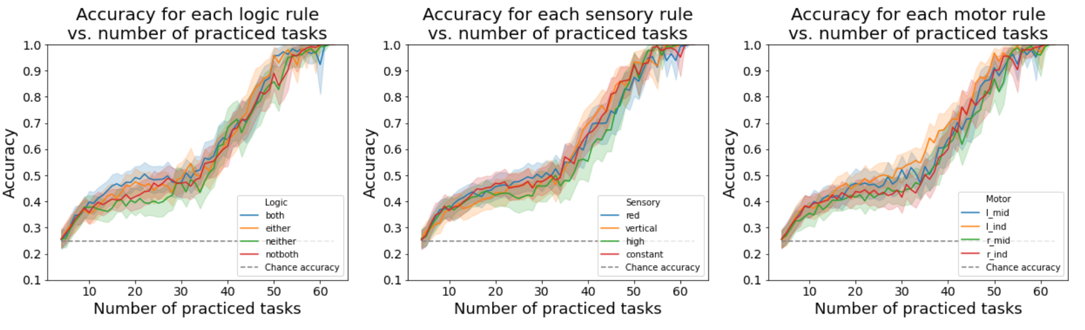
ANN equivalent of by-rule analysis – Adam x no pretraining
Without pretraining, you no longer see this distinction

Slide 47
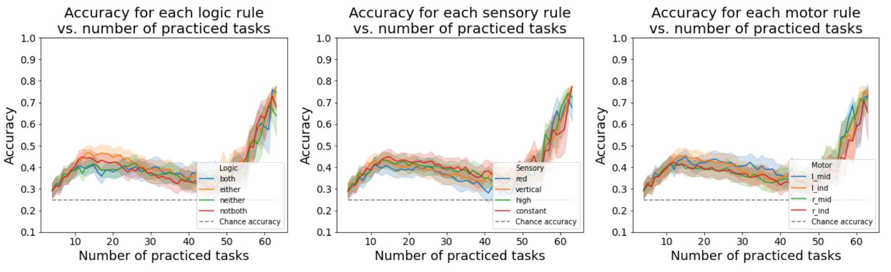
ANN equivalent of by-rule analysis – SGD x no pretraining
Without pretraining, you no longer see this distinction

Slide 48
How are the task rule inputs modeled?
both
either
not
red
vertical
high
constant
lmid
lind
rmid
rind
Logic
Sensory
Motor

Slide 49
How are simple/primitive tasks modeled? Logical-sensory primitive task
both
either
not
red
vertical
high
constant
lmid
lind
rmid
rind
Logic
Sensory
Motor
If EITHER stimulus is VERTICAL, output TRUE; else FALSE
both
either
not
red
vertical
high
constant
lmid
lind
rmid
rind
Logic
Sensory
Motor
If NEITHER stimulus is HIGH, output TRUE; else FALSE

Slide 50
How are simple/primitive tasks modeled? Sensorimotor primitive task
both
either
not
red
vertical
high
constant
lmid
lind
rmid
rind
Logic
Sensory
Motor
If stimulus is VERTICAL, output RMID; else RIND
both
either
not
red
vertical
high
constant
lmid
lind
rmid
rind
Logic
Sensory
Motor
If stimulus is HIGH, output RIND; else RMID

Slide 51
Why are ANNs biased towards affirmative (BOTH & EITHER) rules, rather than negative rules?
Hypothesis – Questions that we pose are inherently biased towards affirmative conditionals
Ex: If RED then press RMID
Observation: Questions can be inherently biased towards negative conditionals, too
Ex: If NOT RED, then press RMID
Hypothesis: Train network only on negative conditionals in the sensorimotor primitive task

Slide 52
Converting affirmative conditionals to negative conditionals in the sensorimotor primitive task
both
either
not
red
vertical
high
constant
lmid
lind
rmid
rind
Logic
Sensory
Motor
If stimulus is NOT VERTICAL, output RMID; else RIND
both
either
not
red
vertical
high
constant
lmid
lind
rmid
rind
Logic
Sensory
Motor
If stimulus is NOT HIGH, output RIND; else RMID

Slide 53
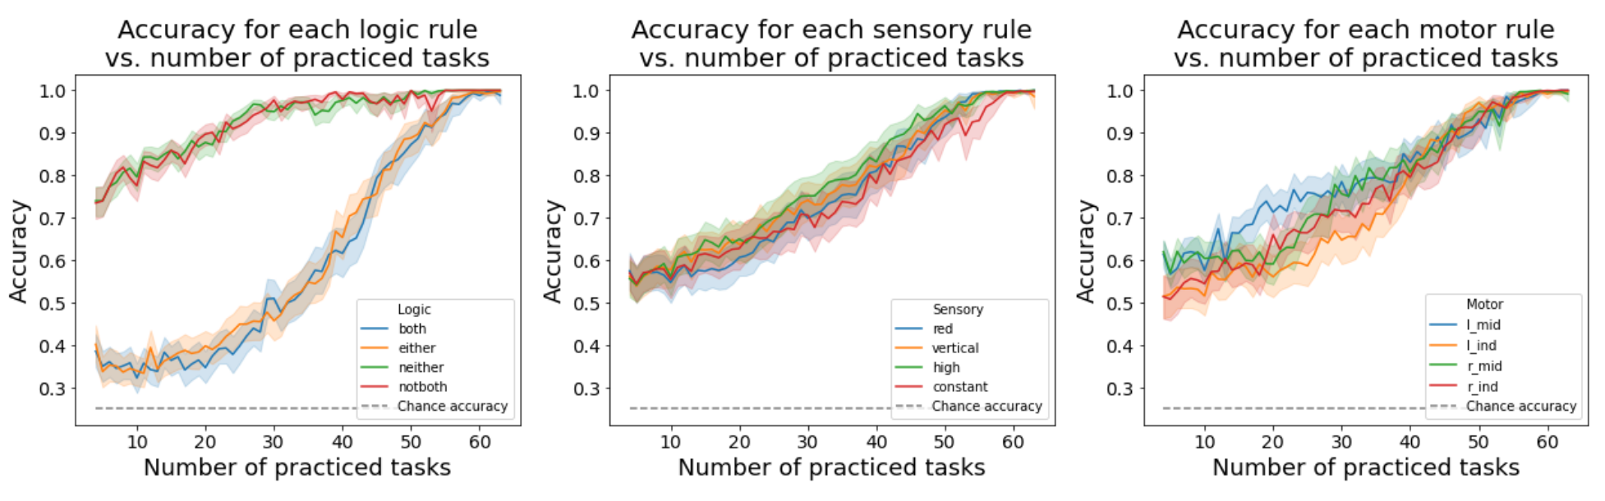
Evaluating task performance by specific rules
Performance on specific logical rules is flipped – rules involving negations outperform ‘affirmative’ rules

Slide 54
What if we pretrained the networks on both affirmative and negative versions of the sensorimotor primitive task?

Slide 55
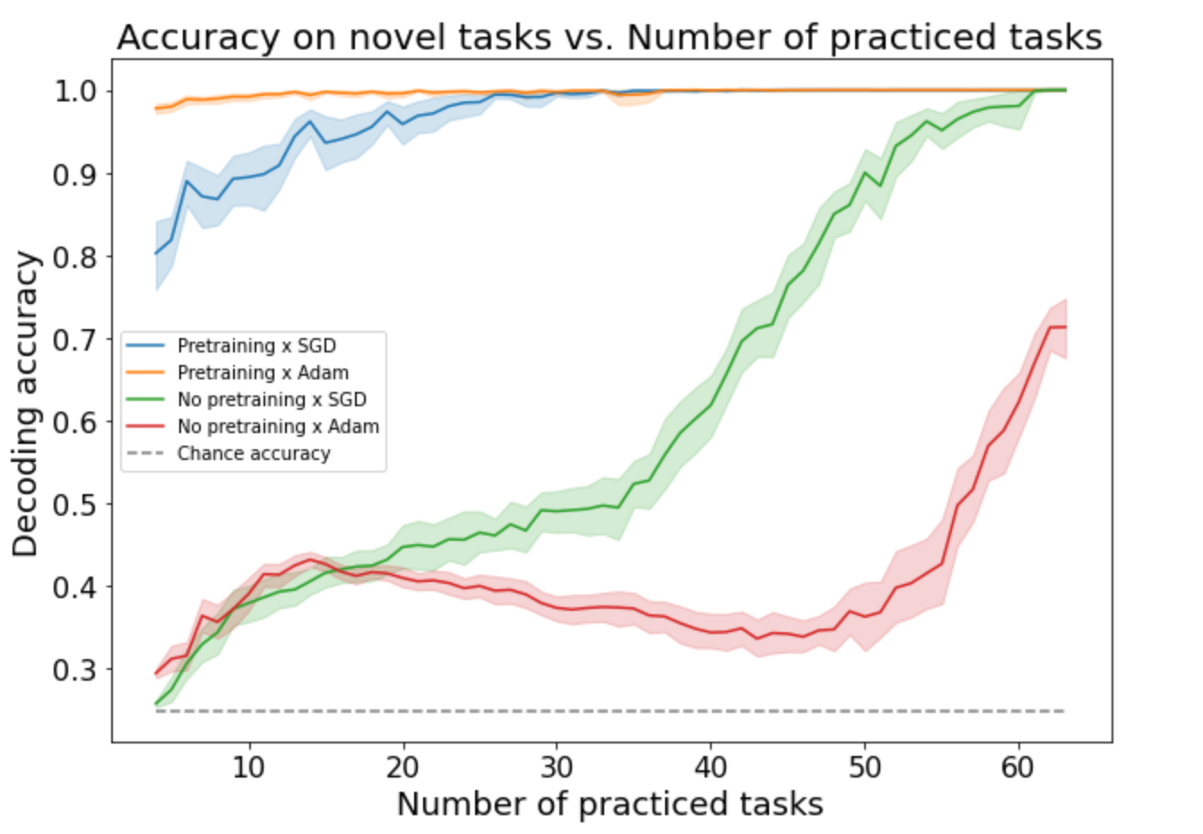
Training on both affirmative + negative sensorimotor primitive tasks yields nearly perfect performance after training on just 4/64 tasks

Slide 56
What about zero-shot learning on the full C-PRO task?
Pretrained tasks have never seen all 3 rules together
Would be a demonstration of systematicity and productivity (extending 2 rule to 3 rule tasks)

Slide 57
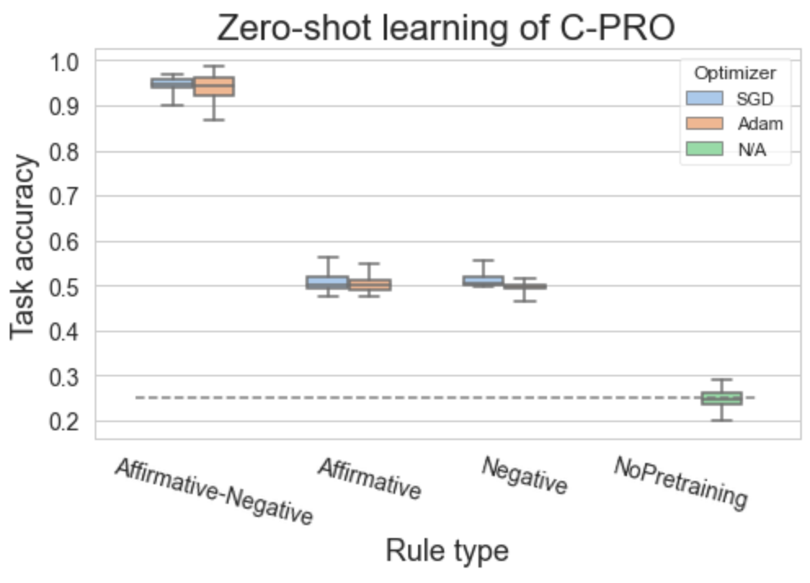
Highly accurate zero-shot learning when training on both affirmative & negative sensorimotor primitive tasks

Slide 58
Same results if ‘not both’ and ’neither’ are encoded separately
both
either
not both
neither
red
vertical
high
constant
lmid
lind
rmid
rind
Logic
Sensory
Motor

Slide 59
Empirical fMRI results
Objective: identify how and where the brain represents compositional information
Previous work has shown that the brain contains compositional representations (Reverberi et al. 2012; Cole et al. 2015)
But what are the computational properties of compositional representations, and why are they useful?

Slide 60
Approach
Identify regions that are sensitive to compositional representations
Test for…
Regions sensitive to novelty (i.e., practiced versus novel tasks), since novelty-sensitive regions are likely involved in flexible re-use of compositions (Cole et al. 2016)
Regions that are sensitive to negations – within Logic rules, we can group NEITHER + NOT BOTH versus EITHER and BOTH
Cross condition generalization performance (CCGP) (Reverberi et al. 2012; Bernardi et al. 2020) – question for Mattia: CCGP with distance-based classification would suggest the clustering of representations?
Parallelism – the degree of ‘abstractedness’ in a brain region (Bernardi et al. 2020)

Slide 61
Novelty results
For each task block (which includes a single task context), label it as either ‘practiced’ or ‘novel’
Run a cross-subject decoding on novel and practiced blocks, testing on held-out subjects (10-fold)
Note that each subject has distinct practiced task contexts they are trained on

Slide 62
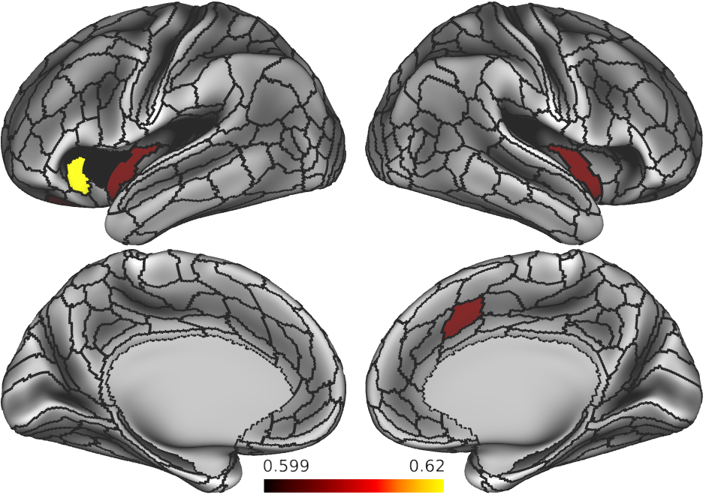
Regions sensitive to novelty?

Slide 63
Regions sensitive to negations
If a brain area represents information compositionally, it should be able to disentangle affirmative conditions (BOTH & EITHER) from negations (NOT BOTH & NEITHER)
This is another form of cross-condition generalization
Cross-subject 10-fold cross validation

Slide 64
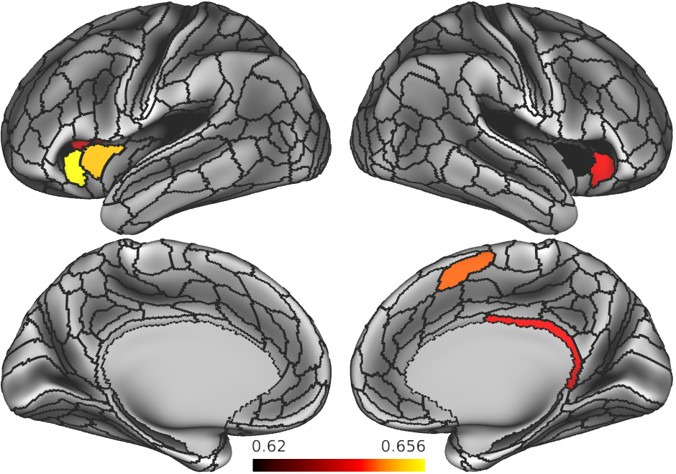
Regions sensitive to negations?

Slide 65
CCGP results
Extract 64 task contexts
For each rule domain decode logic rules (BOTH v EITHER v NOTBOTH v NEITHER)
By definition, since there’s only one sample per task context, this is CCG

Slide 66
Parallelism results
Extract 64 task contexts
For each rule domain compute the degree of parallelism between each pair of rules across contexts
Ex, to test compositionality and coding directions of BOTH and EITHER rules, test if the following 2 vectors are parallel
VECTOR1: BOTH – RED – LMID → EITHER – RED – LMID
VECTOR2: BOTH – VERTICAL – RMID → EITHER – VERTICAL – RMID

Slide 68
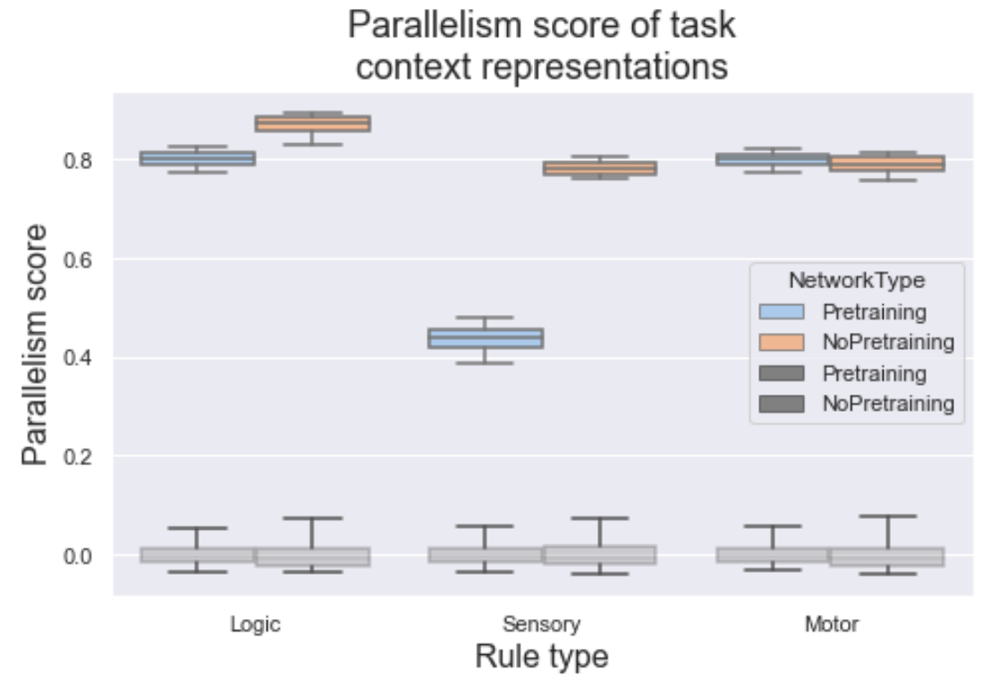
Measure abstractedness using parallelism score

Slide 69
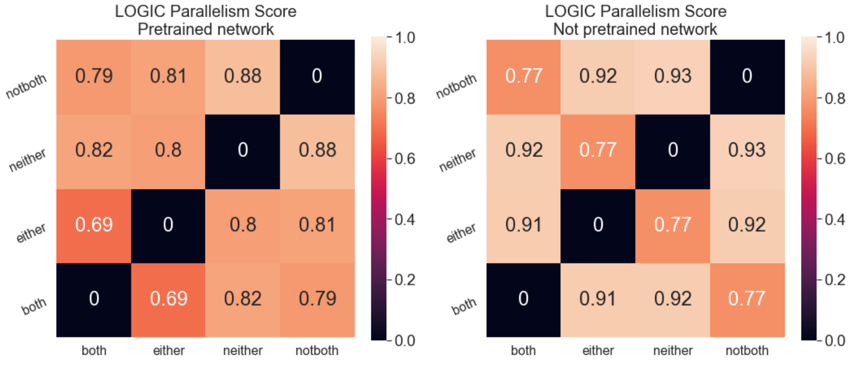
Logic specific cosine angles

Slide 70
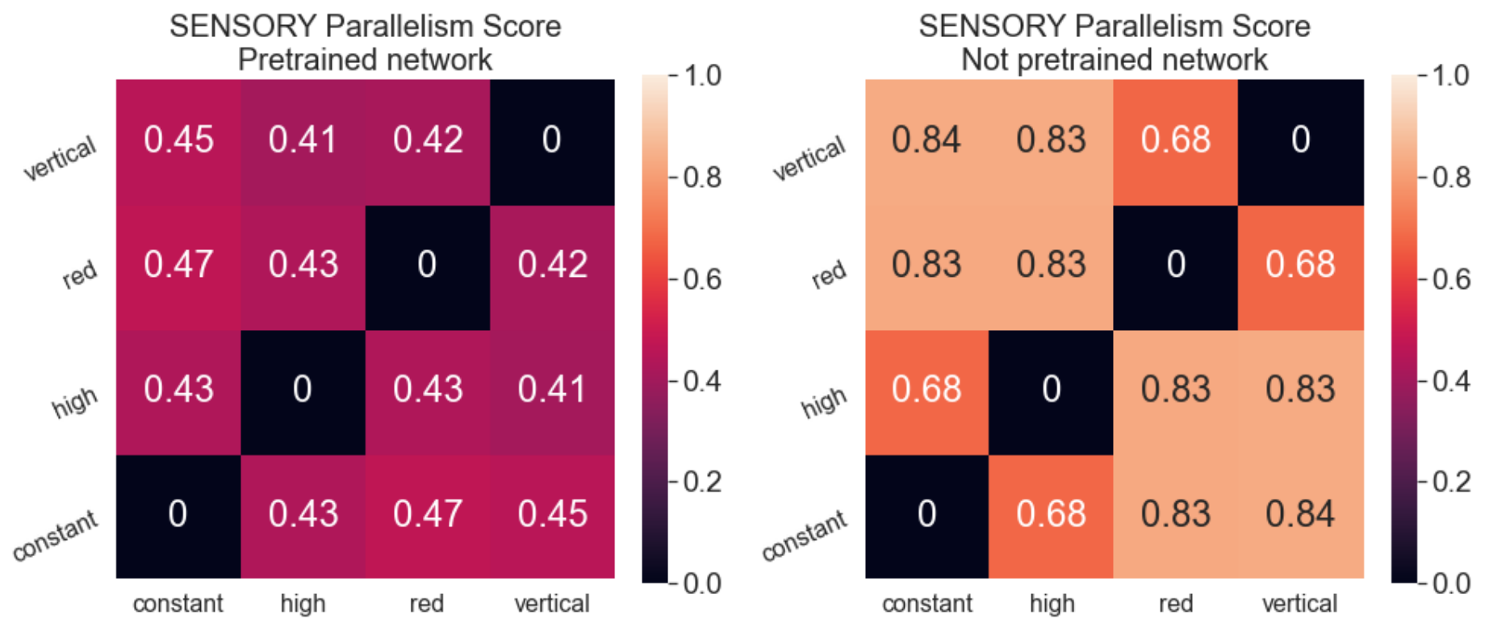
Sensory specific cosine angles

Slide 71
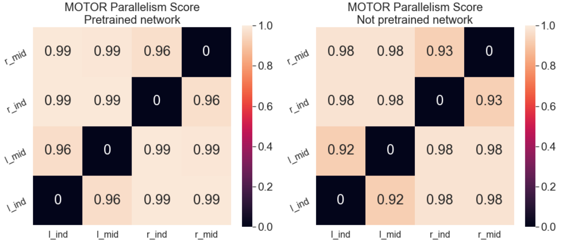
Motor specific cosine angles

